Slide 1

Job-Driven VR Technical Assistance Center Learning Collaborative Meeting
Cohort 2: Panel Presentations
February 8-9, 2017
Nashville, tn

Slide 2
Integrating Labor Market Information into Agency Practice
Panel 1: PROJECT UPDATES

Slide 3
Colorado DVR
Jennifer Scilacci, Manager WSEE Unit
Jeff Sidders, Business Outreach Specialist

Slide 4
What is the ultimate end goal of your project?
Increase the systematic use of LMI within CO DVR to produce better client outcomes including increased client wages
Infusion of LMI throughout comprehensive assessment
Use of The Career Index Plus beginning at application with clients
LMI is used at all levels of the Agency
Have clear expectations for use of LMI for all groups
Colorado VR
Notes:
Please refer to your technical assistance plan.

Slide 5
What Have We Done So Far?
Surveyed Staff on Use of LMI in Summer 2016
Goal was to see use of various types of LMI resources in use by counselors
What types of assessments were being used in the field
What could be done to begin to increase wages for clients
Colorado VR

Slide 6
Do you use labor market information when analyzing your client's job interests and priorities?
Answer Choices– | Responses–
–never | 1.64% (1)
–rarely | 4.92% (3)
–sometimes | 39.34% (24)
–often | 22.95% (14)
–always | 31.15% (19)
Total | 61
Colorado VR

Slide 7
Specific LMI Resources Used By Staff
Onet
Occupational Outlook Handbook
ESMI career coach
Job postings on the internet
Contact employers directly
Bureau of Labor Statistics
Contact WFC directly
Colorado VR

Slide 8
What tools or resources do you currently use during career exploration activities with your clients?
Answer Choices– | Responses–
–Interest Inventories | 75.00% (45)
–Counseling and Guidance | 98.33% (59)
–Situational Assessments | 78.33% (47)
–Discovery | 6.67% (4)
–Informational Interviews | 63.33% (38)
–O*Net | 95.00% (57)
–LMI Gateway | 21.67% (13)
–BOS information | 35.00% (21)
Total Respondents: 60 | Comments(21)
Colorado VR

Slide 9
Research of LMI Tools in CO and Next Steps
CO Team researched existing LMI Tool in CO – LMI Gateway
The Career Index Plus (TCI +) was demonstrated at a JD-VRTAC call and with Leadership
Field Staff has been introduced to TCI + and the upcoming trainings offered on TCI +
Colorado VR

Slide 10
What changes have you made or plan to make? How is it different than “business as usual”?
Training Curriculum will be developed on LMI for all staff
Training will introduce specific tools for each user group
Curriculum will include benefits to each user
Expectations on how to use LMI will be included
TCI+ will come to CO twice to train on TCI+
General LMI Information
CO Specific Information – i.e. LMI Gateway
TCI + and specific uses – by TCI+
Include TCI + use on upcoming Field Supervisor Agendas
Colorado VR
Notes:
Training curriculum developed for all staff, and geared for specific user groups, such as VR Counselors, Business Outreach Specialists, Supervisors and Leadership
Specific Tools within LMI Gateway, TCI + will be identified and trained on for each user group to facilitate use on these resources and ensure the resources are fully used
Benefits to each user group will be highlighted, such as the career pathways, interest inventories, and benefits planning available in TCI + for counselors and job descriptions for Business Specialists.
Clear expectations on how and when to use the LMI resources, including business outreach specialists, will be included

Slide 11
What tips would you have for an agency looking to implement a similar process?
Buy-in and involvement from Upper Management
Survey field staff to learn how and when they use LMI
Involve Training Unit in developing curriculum and training all staff
Difficulties: how to get training in person to rural areas of state
Colorado VR

Slide 12
State of Connecticut Department of Rehabilitation Services Bureau of Education and Services for the Blind
Mary Burgard, VR Supervisor
Jonathan Richmond, VR Counselor Coordinator

Slide 13
What is the ultimate end goal of your project?
Use of LMI in the VR process by the VR Counselors
Client involvement to independently research occupations that interest them
Using LMI to expand employer engagement
VR Counselor’s increased knowledge of employer needs within their territory
Connecticut BESB
Notes:
Please refer to your technical assistance plan.

Slide 14
What changes have you made or plan to make? How is it different than “business as usual”?
Time management by streamlining paperwork for the VR Counselors
Conducted survey to get a baseline of use of LMI in the VR Process
Future training for Staff on use of LMI & Ethical Considerations
Increased employer outreach by Counselors
Use of LMI consisting of traditional, real-time sources and as anecdotal sources of information gathered through relationships with employer
Usage and future training of The Career Index Plus
Connecticut BESB

Slide 15
What tips would you have for an agency looking to implement a similar process?
Streamline so they have appropriate time
Have VR Counselors involved in the process
Survey
Training
Identify your LMI source- do not get embroiled with using extraneous resources
Connecticut BESB

Slide 16
CRPs for Business Engagement
Panel 2 PROJECT UPDATES

Slide 17

Christine Robinson
Director of Systems Improvement and Quality Assurance

Slide 18
What is the ultimate end goal of your project?
The goal is to realize:
- better employment outcomes
- more efficient use of resources
- better retention rates by keeping clients engaged and moving through the VR process
Maine BRS
Notes:
Please refer to your technical assistance plan.

Slide 19
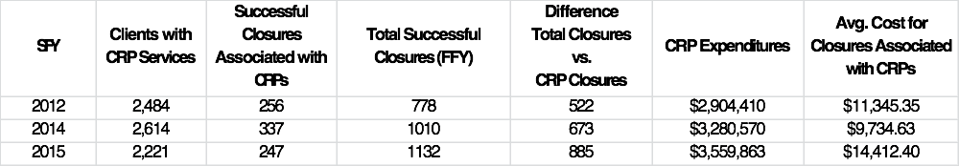
A Brief History and a Look at the Data (see handout)
Maine BRS

Slide 20
What changes have you made or plan to make? How is it different than “business as usual”?
Change from outcome based payment to a hybrid system (see handout)
Revised reporting formats
Currently use almost exclusively CRPS for building employer relations
Pilot – transitioning one VRC position to in house business relations specialist
Plan is to incorporate WIOA partners
Implementing the Progressive Employment Model (VT) across the state
Maine BRS

Slide 21
What tips would you have for an agency looking to implement a similar process?
Plan Do Check Act
Look at the data
Use a project plan process to help you understand where you want to go and where you have been
Include a variety of stakeholders in the process
Maine BRS

Slide 22

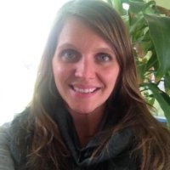
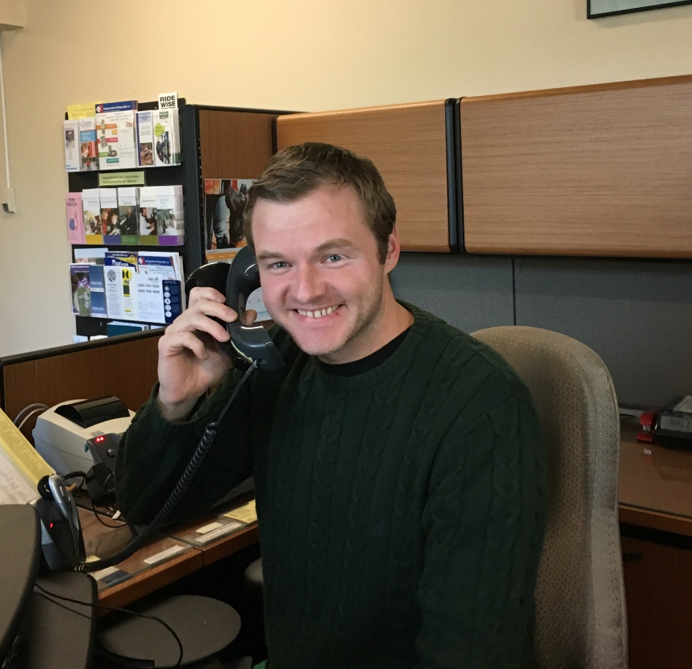
Morgan Rincon, M.S., CRC
&
Vinnie Gwozdz, M.S., CRC

Slide 23
What is the ultimate end goal of your project?
Implementation of business engagement database
Building state-wide consistency in business engagement efforts
Building business engagement capacity
Oregon CFB
Notes:
Please refer to your technical assistance plan.

Slide 24
Implementation of business engagement database:
Increase # of businesses engaged with OCB
Track # of businesses interacting with Progressive Employment activities
Track main points of contact from OCB or CRPs interacting with business
Track accessibility and # of businesses OCB provided initial tech assessment to
Oregon CFB

Slide 25
Building state-wide consistency in business engagement efforts:
Provide training to VRCs & CRPs in our Business Engagement efforts, PE model, services to employers, mission, message and language continuity.
Improve BE marketing material for OCB
Increase # of CRPs to provide job development across state
Increase # of PE activities for clients and interactions with businesses (info interviews, company tours, job shadows, work experiences) and initial technology/ accessibility assessments
Oregon CFB

Slide 26
Building business engagement capacity:
Utilizing and supporting VRC staff in business engagement efforts
ID internal and external resources (VRCs, tech staff, CRPs, etc.)
Oregon CFB

Slide 27
What changes have you made / do you plan to make? How is it different from “business as usual”?
Realization that OCB needs to track & record business engagement for Business Enterprise Program (BEP) & technology staff
Will benefit job developers reaching out to businesses as well as tech staff initiating accessibility conversations with businesses.
Will help steer the conversation with clients when developing IPE.
More conversation re: “who’s worked with anyone in the __ industry?”
Oregon CFB

Slide 28
Continued…
Lots of dialogue in Jobsville between CRPs & VRCs on weekly basis
Plan to include our technology training Ctr. director in weekly meetings
Outreach to general OVR CRPs with letter of interest to apply with OCB
Follow up with phone calls, in person meetings, assisting with application process
Work on updating RFA to make it easier
Oregon CFB

Slide 29
Continued…
Drafted a Business Enterprise Program (BEP) tracking log ready to implement
Created new & improved BEP brochures and shared with CRPs to use
Providing training to CRPs including BEP material, PE model, technology staff…. on going… great response from our partners!
Stronger presence of OCB in the CRP community & increased partners with involvement in PE & weekly Jobsville meetings
Increased business engagement and PE activities across state
Increased request for technology assistance
Oregon CFB

Slide 30
Continued…
Working with VR from OR general & WA general, blind & tribal called: Interstate Disability Employment Alliance to share business resources, etc.
Working with OVR general partner, Incight, to provide job fairs, employer outreach & disability awareness & education
Working on facilitation of BLN in Portland area with support from USBLN, local CRP & NET (employer roundtable)
Working with OVR general SRC business engagement committee
OCB Expo 2nd annual
Marketing video
Oregon CFB

Slide 31
What tips would you have for an agency looking to implement a similar process?
Take part in COP calls
Talk with other states- brainstorm ideas
“Borrow” tools and resources from other VR agencies
Important to have key players on board to help implement
Oregon CFB

Slide 32
Business Relations
Panel 3 PROJECT UPDATES

Slide 33
Notes:
Front Cover Slide

Slide 34
South Carolina Vocational Rehabilitation Department
Darline Graham, Public Information Director
Anne Iriel, Assistant Commissioner
Notes:
Title Slide – Add your presentation title and an optional subtitle and your name (the date will pop in automatically)

Slide 35
What is the ultimate end goal of your project?
Strengthen Business Relationships and Services:
Marketing Through Community Involvement – A Multi-Customer Approach
Staff skilled in business engagement strategies and approaches
Data Management System
Notes:
Blank Slide – place text boxes, video clips or whatever you want here

Slide 36
What changes have you made or plan to make? How is it different than “business as usual”?
Redesign of Client Services training
Development of Business Engagement Training
Big Picture Tour
Continual Development of Career Connect
VR Ambassadors Program

Slide 37
What tips would you have for an agency looking to implement a similar process?
Recognize different points of view and provide learning activities to promote critical thinking
Include various departments: client services, business services, finance, public information, program evaluation, etc. in planning and implementation

Slide 38
What tips would you have for an agency looking to implement a similar process? (cont’d)
When developing a data system consider impact on entire system (no “silos”)
Continual reinforcement, education and follow up for local staff

Slide 39
Tennessee Vocational Rehabilitation
Trish farmer and diedra sawyer

Slide 40
What is the ultimate end goal of your project?
Increase employment opportunities for individuals served by TN Vocational Rehabilitation by providing human resource services to Tennessee businesses.
Increase and strengthen VR’s business relationships statewide.
Enhance and diversify our current business partnership network.
Tennessee VR
Notes:
Please refer to your technical assistance plan.

Slide 41
What changes have you made or plan to make? How is it different than “business as usual”?
Decision made for all Business Employment Consultants (BECs) to form 1 unit & supervised by 1 person (vs. current: various supervisors in the field).
Developed a staff survey on knowledge/use of LMI & other resources during voc. Planning to provide info to the new business unit. To date, there have been no surveys or formal trainings for field staff about LMI.
Looking at case management software to help track business units activities (new business initiatives, & services provided to businesses/clients).
Tennessee VR
Notes:
1.

Slide 42
What tips would you have for an agency looking to implement a similar process?
Set a vision
Research the client and business needs of the state as you work to develop the business service unit
Education/Training of staff
Work on developing partnerships and engagement strategies
Tennessee VR

Slide 43


Montana Vocational Rehabilitation and Blind Services
Chanda Hermanson-Dudley, Chief of Field Services
Jacob Kuntz, CRC VRBS Counselor

Slide 44
What is the ultimate end goal of your project?
Develop program capacity for engaging and supporting businesses
Integration of Labor Market Information in the VRBS counseling practice.
Decrease the overall unemployment rate for Montanan’s with disabilities
Montana VRBS
Notes:
Please refer to your technical assistance plan.

Slide 45
What changes have you made or plan to make? How is it different than “business as usual”?
Montana established a statewide Business Services Specialist position and team of staff to assist in the delivery of business services
Developing formal job descriptions & performance appraisals for Business Team staff
Initiated pilot projects for business engagement
Disability Attitudinal training for Labor & VR to deliver to Business
Creating marketing materials, including a website specific to Business
Staff attendance at Job Service Employer Councils, SHRM, Chamber of Commerce & Community Management Team meetings
Establishing a budget line for Business Services expenses
Montana VRBS

Slide 46
What tips would you have for an agency looking to implement a similar process?
Get involved with a TAC
Talk to other states regarding their efforts
Attend the Learning Collaborative, participate in Communities of Practice, Regional teams
Keep all partners (CRPS, Job Service, etc) in mind as you expand services
Montana VRBS

Slide 47

Presenters:
Shaylon Ware, Rehabilitation Manager, District VIII Ashley Cross, Corporate Business Relations Manager

Slide 48

What is the ultimate end goal of your project?
Project Objectives:
1. Understand & apply LMI to increase competitive integrated employment outcomes.
2. Increase collaboration between Business Relations Team & the rest of the agency.
3. Increase agency engagement & participation with business leadership & partner service agencies.
Arkansas RS
Notes:
Please refer to your technical assistance plan.

Slide 49
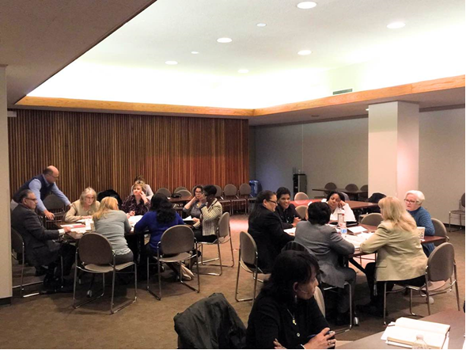
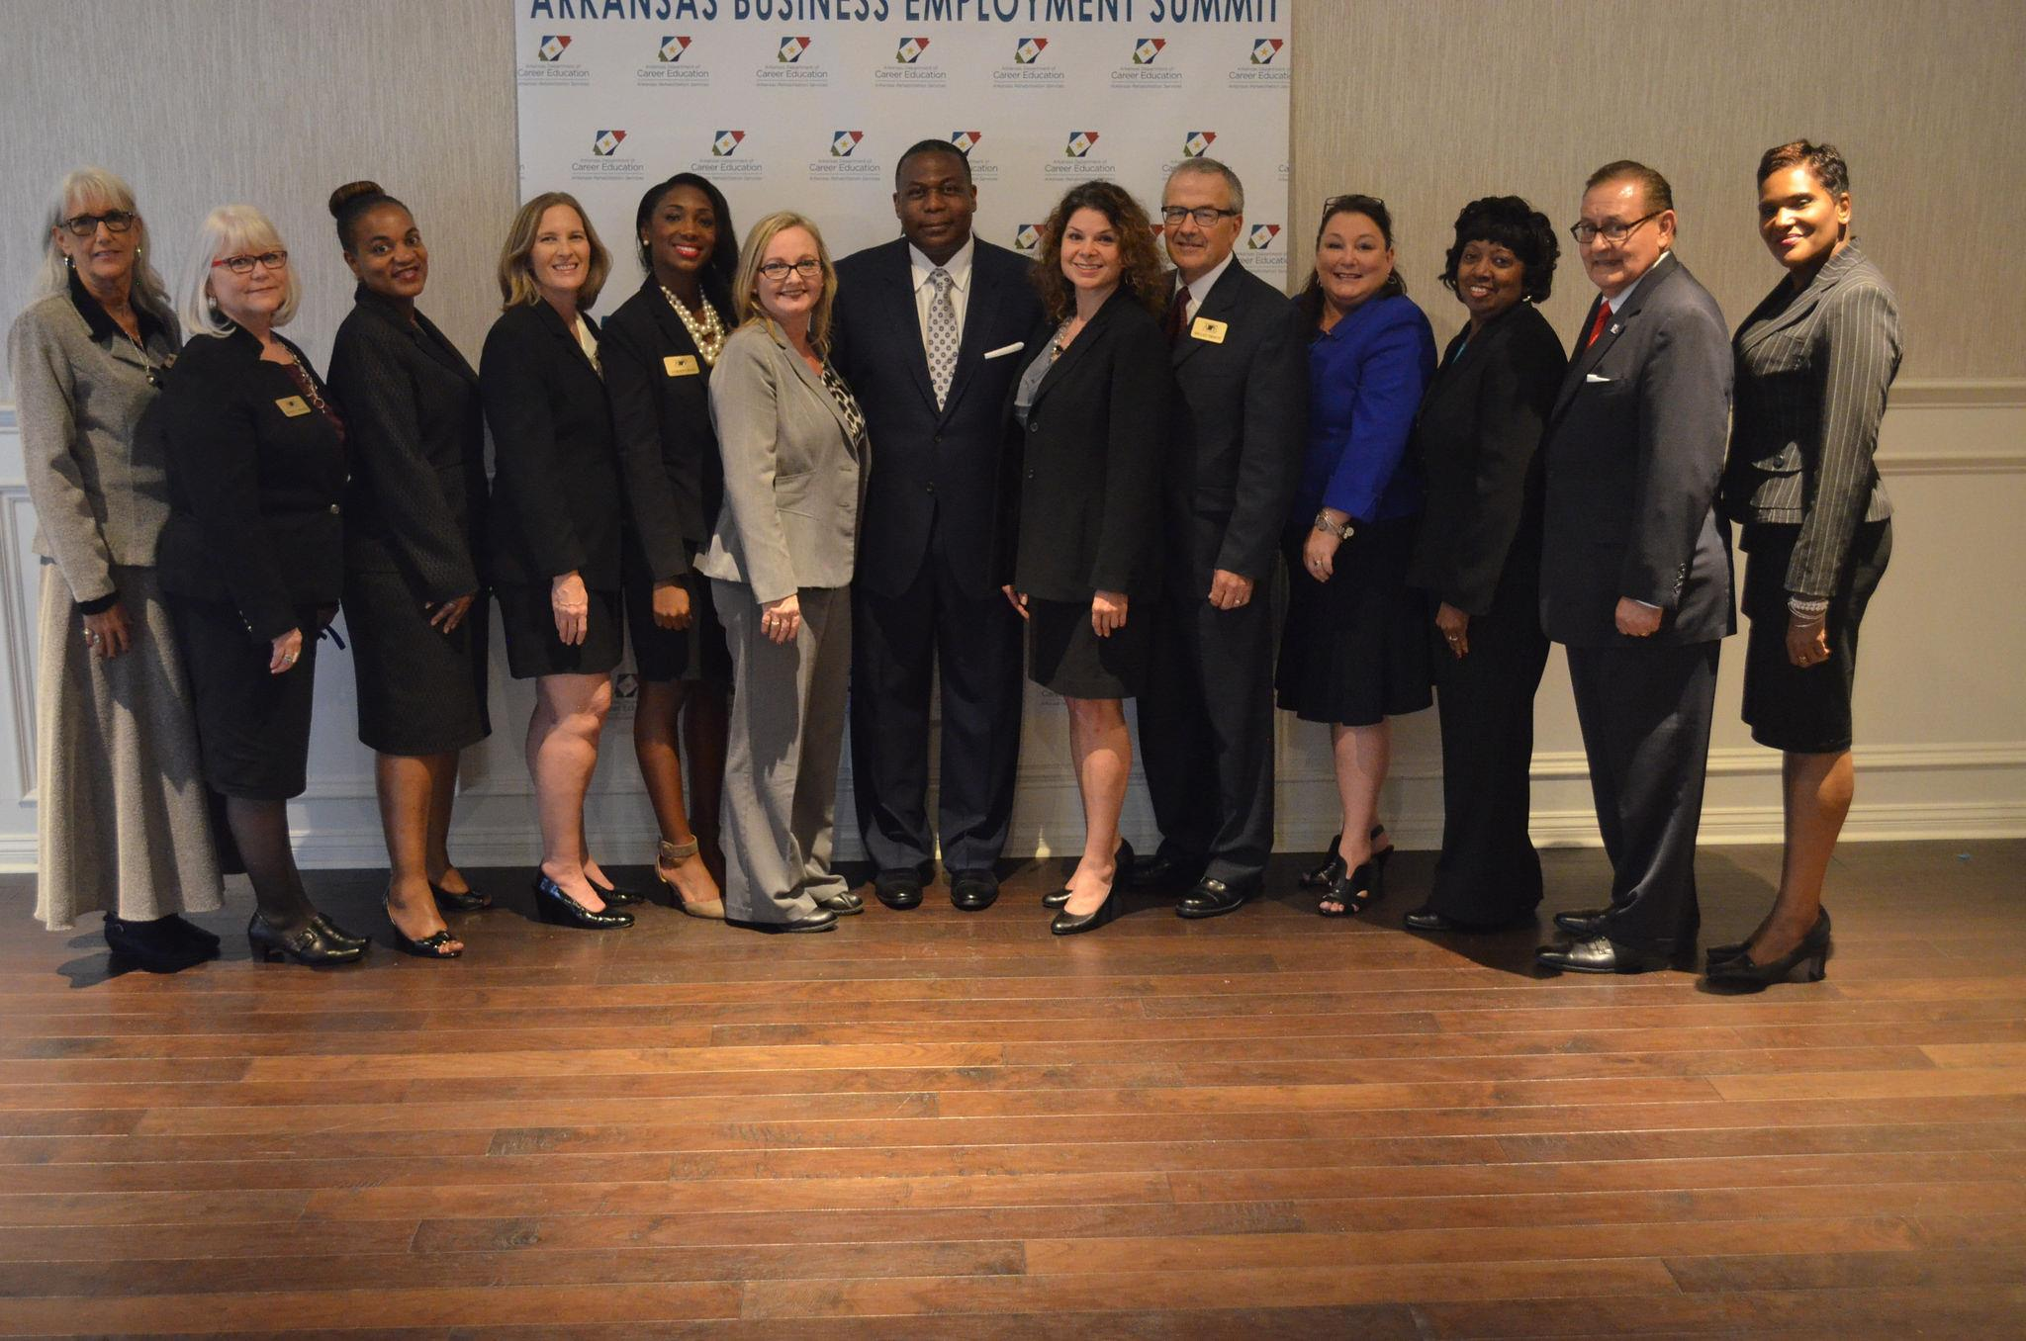
What changes have you made or plan to make? How is it different than “business as usual”?
Improve collaboration at all levels of the agency leading to increased competitive integrated employment outcomes.
Arkansas RS

Slide 50
What tips would you have for an agency looking to implement a similar process?
Engage Senior management
“Buy In” from all contributing parties
Implement proactive engagement
Periodically and systematically review Agency Action Plan to ensure focus and maintain momentum
Arkansas RS

Slide 51

Arkansas RS

